Slide 1
Coursera Capstone IBM Applied Data Science Capstone
Opening a New Indian restaurants in Delhi, India
By Gokul Krishnan
June 2020

Slide 2
Business Problem
Location of the Indian restaurants is one of the most important decisions that will determine whether the mall will be a success or a failure
Objective: To analyze and select the best locations in the city of Delhi, India to open a new Indian restaurants
This project is timely as the city is currently suffering from oversupply of Indian restaurants
Business question ➢In the city of Delhi, India, if a property developer is looking to open a new Indian restaurants , where would you recommend that they open it?

Slide 3
Data
Data required
List of neighborhoods in Delhi
Latitude and longitude coordinates of the neighborhoods
Venue data, particularly data related to Indian restaurants
Sources of data
Wikipedia page for neighborhoods (https://en.wikipedia.org/wiki/Category:Neighbourhoods_in_Delhi)
Geocoder package for latitude and longitude coordinates Foursquare API for venue data

Slide 4
Methodology
Web scraping Wikipedia page for neighborhoods list using Beautiful Soup
Get latitude and longitude coordinates using Geocoder
Use Foursquare API to get venue data
Group data by neighborhood and taking the mean of the frequency of occurrence of each venue category
Filter venue category by Indian restaurants
Perform clustering on the data by using k-means clustering
Visualize the clusters in a map using Folium

Slide 5
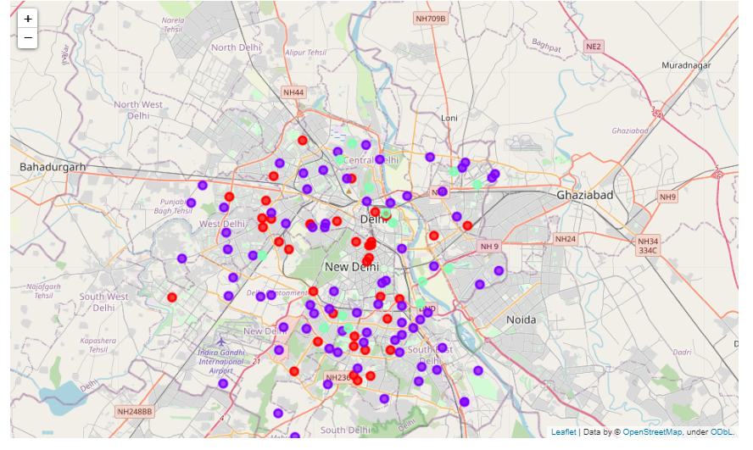
Results
Categorized the neighborhoods into 3 clusters :
Cluster 0: Neighborhoods with moderate number of Indian restaurants
Cluster 1: Neighborhoods with low number to no existence of Indian restaurants
Cluster 2: Neighborhoods with high concentration of Indian restaurants

Slide 6
Discussion
Most of the Indian restaurants are concentrated in the central area of the city
Highest number in cluster 2 and moderate number in cluster 0
Cluster 1 has very low number to no Indian restaurants in the neighborhoods
Concentration of Indian restaurants mostly happened in the central area of the city, with the suburb area still have very few Indian restaurants

Slide 7
Recommendations
Open new Indian restaurants in neighborhoods in cluster 1 with little to no competition
Can also open in neighborhoods in cluster 0 with moderate competition if have unique menu(Dishes) propositions to stand out from the competition
Avoid neighborhoods in cluster 2, already high concentration of Indian restaurants and intense competition

Slide 8
Conclusion
Answer to business question:
The neighborhoods in cluster 1 are the most preferred locations to open a Indian restaurants
Findings of this project will help the relevant stakeholders to capitalize on the opportunities on high potential locations while avoiding overcrowded areas in their decisions to open a Indian restaurants.

